Slide 1

INTERPRETML vs AIX 360
Using SHAP

Slide 2
Agenda
Dataset
SHAP
SHAP VS LIME
InterpretML
AIX360
InterpretML VS AIX360
Examples & Comparison
Conclusion

Slide 3
Dataset „Population in frankfurt“
Population statistics in Frankfurt
Average ages, families, foreigners, Germans with a migration background
Source:https://www.offenedaten.frankfurt.de/dataset/stadtteilprofile-bevoelkerung

Slide 4
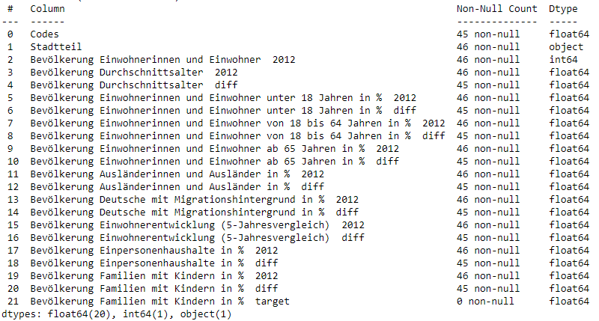
Dataset „Population in frankfurt“

Slide 5
„shap“
SHapley Additive exPlanations
unified framework for interpreting predictions
six methods
SHAP assigns each feature an importance value for a particular prediction. Its novel components include:
the identification of a new class of additive feature importance measures
theoretical results showing there is a unique solution in this class with a set of desirable properties.
Source: http://papers.nips.cc/paper/7062-a-unified-approach-to-interpreting-model-predictions.pdf

Slide 6
SHAP vs lime
LIME
-Approximate a black-box model by a simple linear surrogate model locally
-In some cases faster than SHAP
-It does not work out-of-the-box on all models
SHAP
-To unify various model explanation methods: Model-Agnostic or Model-Specific Approximations
-Based on the game theory „Shapley Values“
-Shapley value is the average contribution of features which are predicting in different situation
Sourcehttps://www.youtube.com/watch?v=d4PPMpdUCz8

Slide 7
„InterpretML“
The package enables practitioners to easily compare interpretability algorithms by exposing multiple methods under a unified API, and by having a built-in, extensible visualization platform.
InterpretML also includes the first implementation of the Explainable Boosting Machine, a powerful, interpretable, glassbox model that can be as accurate as many blackbox models.
Source: https://www.researchgate.net/publication/335975801_InterpretML_A_Unified_Framework_for_Machine_Learning_Interpretability

Slide 8
„AIX 360”
The AI Explainbability 360 toolkit is an open-source library that supports interpretability and explainability of data and machine learning models.
Algorithms:
Local White Box Explainers -> Contrastive Explainers, SHAP Explainers
Local Black Box Explainers
Global White Box Explainers
Directly Interpretable Unsupervised Explainers
Directly Interpretable Supervised Explainers
Source: https://aix360.readthedocs.io/en/latest/?badge=latest

Slide 9



AIX 360 vs InterpretML
Toolkit | Data Explanations | Directly Interpretable | Local Post-Hoc | Global Post-Hoc | Persona-Specific Explanations | Metrics
AIX360
InterpretML
InterpretML Microsoft:
AIX 360 IBM:
MIT License
Apache License 2.0
Source: One Explanation Does Not Fit All: A Toolkit and Taxonomy of AI Explainability Techniques https://arxiv.org/pdf/1909.03012.pdf

Slide 10
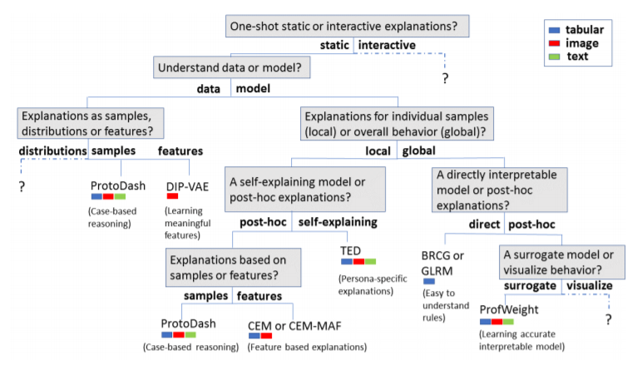
Source: One Explanation Does Not Fit All: A Toolkit and Taxonomy of AI Explainability Techniques https://arxiv.org/pdf/1909.03012.pdf

Slide 11
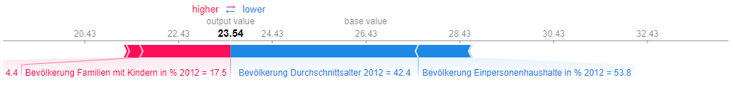
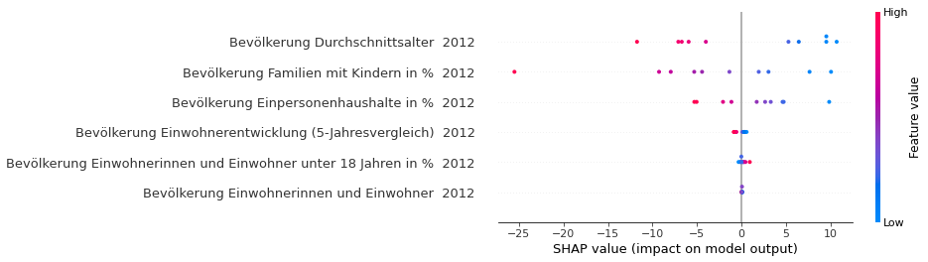
Examples => AIX360

Slide 12
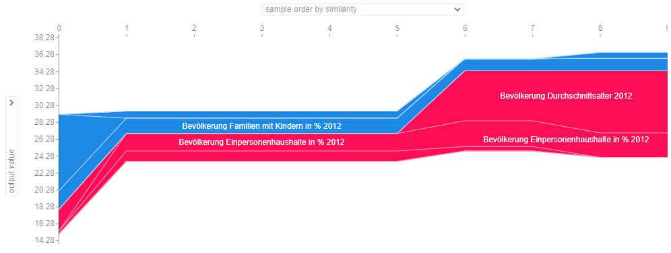
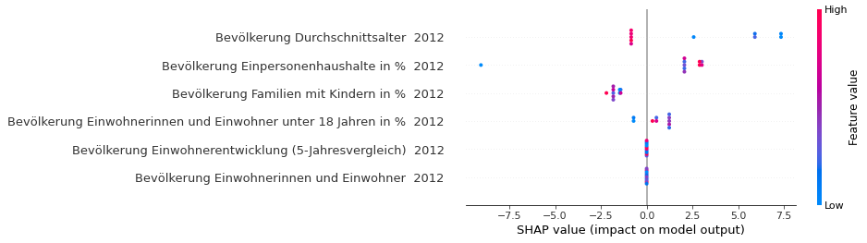
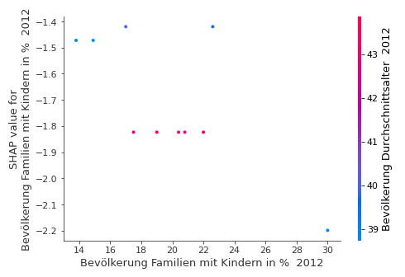
Examples => AIX360

Slide 13
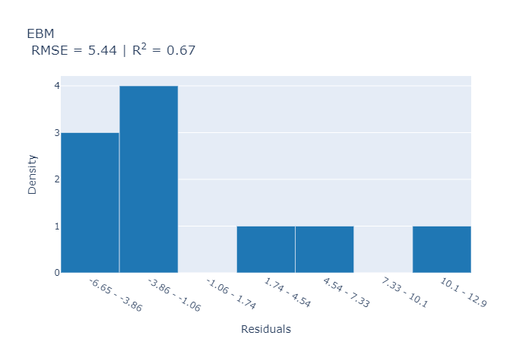
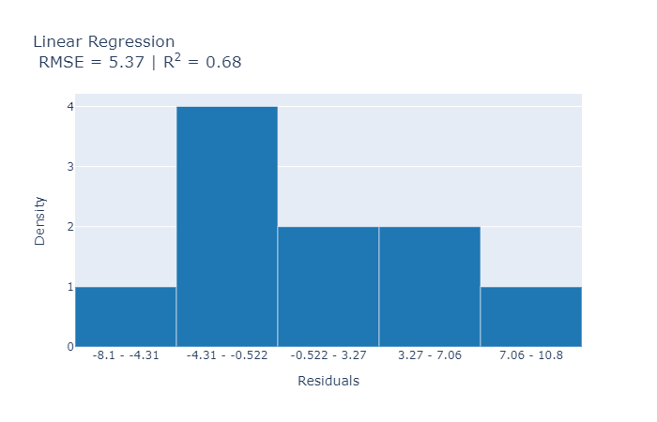
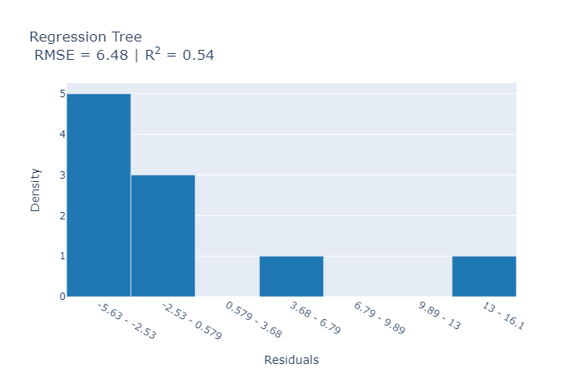
Examples => Interpretml

Slide 14
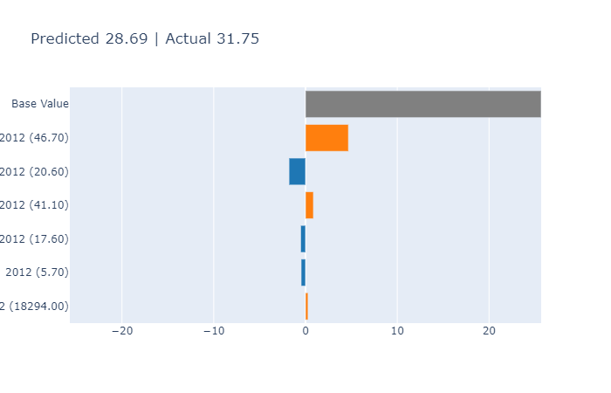
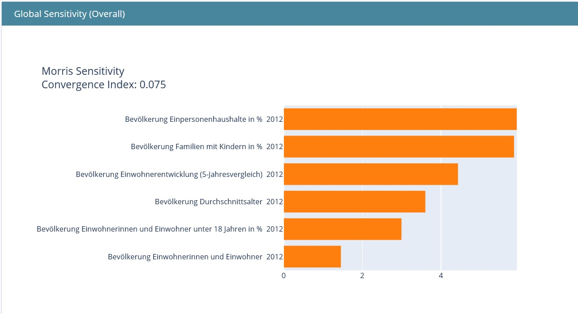

Slide 15
Conclusion

